Slide 1

Incorporando DMARC a tu arsenal Threat Intel
Alejandro Ortuño
NavajaNegra 2018
@aomanzanera

Slide 2


WHOAMI?
Alejandro Ortuño
Security Architect @ Typeform
Previous: Cisco, Rackspace
Co-Organizer BCN CyberSec Meetup
Twitter: @aomanzanera
Email: alejandro.omanzanera@gmail.com
Linkedin: www.linkedin.com/in/aortuno
Notes:
Experiencias pasadas de trabajo

Slide 3
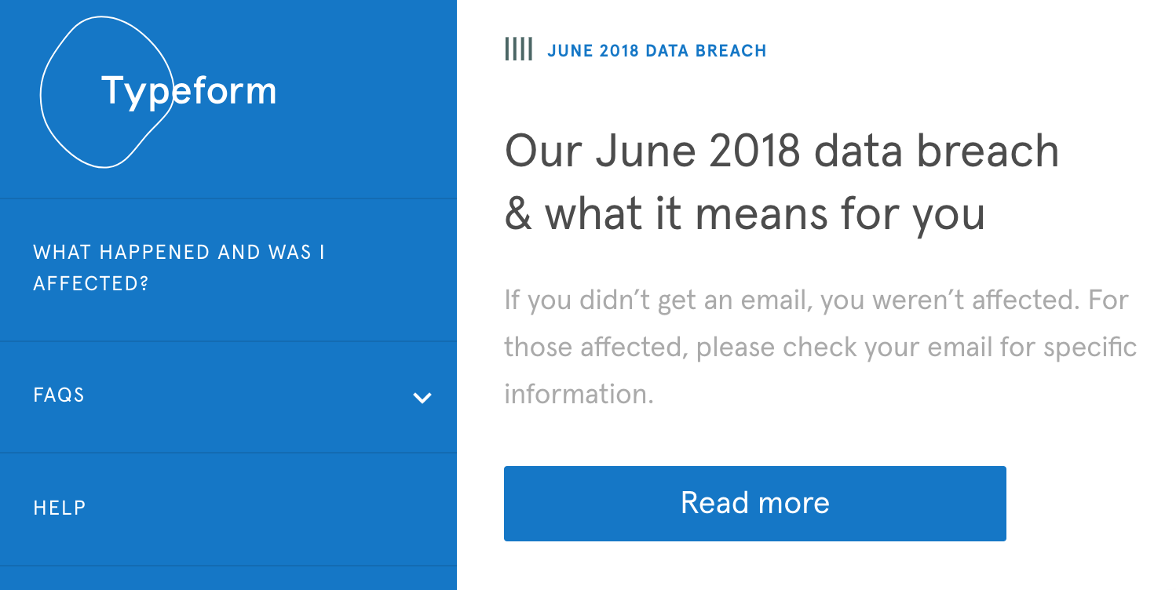
ON A SEPARATE NOTE
Notes:
Charla no esta relacionada.

Slide 4
AGENDA
Email Intro
DMARC
Serverless Solution
Threat Intel
Conclusions
Notes:
Punto de partida - Typeform problemas de entrega de correos
Solucion de zero

Slide 5
AGENDA
Email Intro
DMARC
Serverless Solution
Threat Intel
Conclusions

Slide 6
EMAIL STATISTICS
Created in 1971 Ray Tomlinson
4 billion accounts
300 billion emails / day
50% email Spam
2% malware = 6 billion emails / day
Tuesday day when more emails are opened
Source: https://www.lifewire.com/how-many-emails-are-sent-every-day-1171210

Slide 7
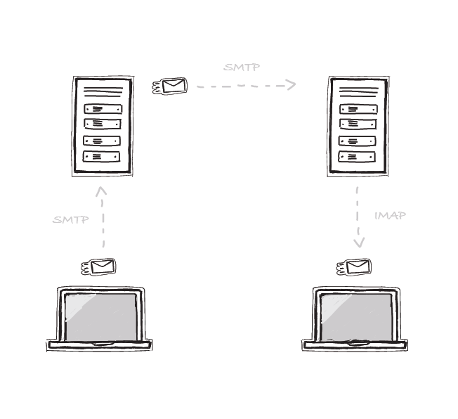

Simple Mail Transfer Protocol (SMTP)
Mail Transfer Agent (MTA)
Internet Message Access
Protocol (IMAP) /
Pop Office Protocol (POP)
Mail User Agent (MUA)
Notes:
Mail User Agent > Cliente de correo
Mail Transfer Agent > Email server / tienda de correos

Slide 8

SMTP - THE ENVELOPE
HELO mta.example.com
ENVELOPE FROM bob@example.com
RCPT TO alice@wonderland.com
SMTP Envelope
Envelope From
RFC5321.MailFrom
Mail From
SMTP From
SMTP Mailfrom (gmail)
Return Path Address
Bounce address
Notes:
Sobre que mandamos al buzon

Slide 9
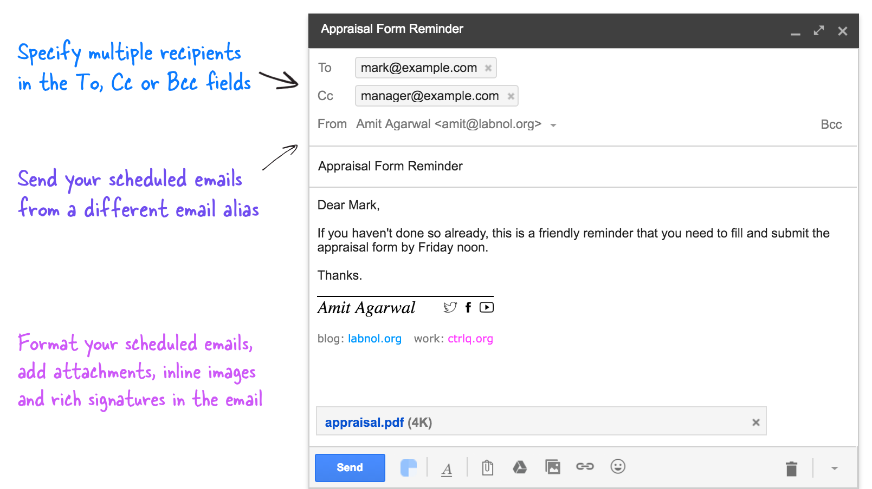
AND THE LETTER
FROM
RFC5322.From
Header From
Display From
Notes:
This will tell us who is the author of the email

Slide 10
SMTP WEAKNESSES
SMTP does not provide authenticity, integrity, and confidentiality of emails

Slide 11
SMTP WEAKNESSES
SMTP does not provide authenticity, integrity, and confidentiality of emails
Sender Policy Framework (SPF)
DomainKeys Identified Mail (DKIM)
Domain-based Message Authentication, Reporting and Conformance (DMARC)

Slide 12
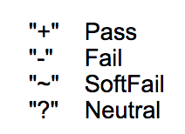
SENDER POLICY FRAMEWORK (SPF)
Hosts authorized used domain on SMTP HELO and Envelope FROM
Notes:
Protocolo 10 años de antiguedad
SPF authorizes and verifies addresses at the mail transport level (SMTP) between two MTAs
Indica las acciones que hacer en caso de fallo

Slide 13
SPF PITFALLS
FROM (visible) not checked
No spoofing protection
Forwarding can break SPF (Sender Rewriting Scheme (SRS))
SPF presence or lack does not impact deliverability
Notes:
SRS for forwarding MTAs to rewrite the sender envelope from address

Slide 14
DOMAINKEYS IDENTIFIED MAIL (DKIM)
Uses asymmetric keys to authenticate email messages.
Sender MTA can decide what to sign (headers / body)
Adds integrity to the message content.
The FROM header field MUST be signed
Can survive email forwarding - not always
Notes:
Can survive email forwarding > dependiendo de lo que sender elija a firmar

Slide 15
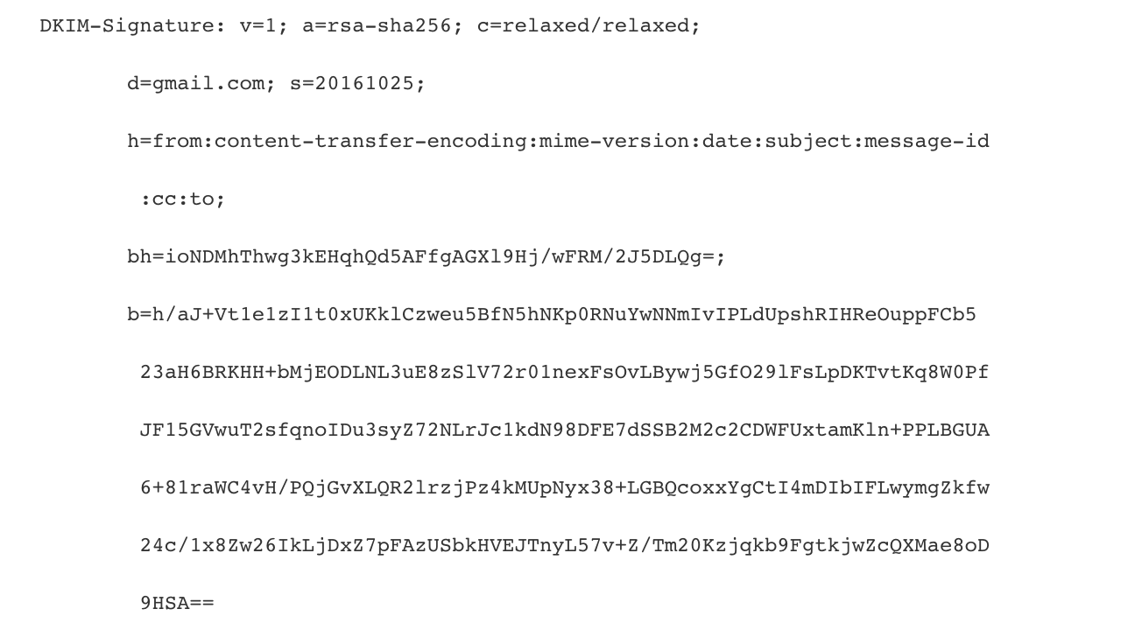
Selector
FROM
Signature
Notes:
Selector > clave privada que se utiliza

Slide 16
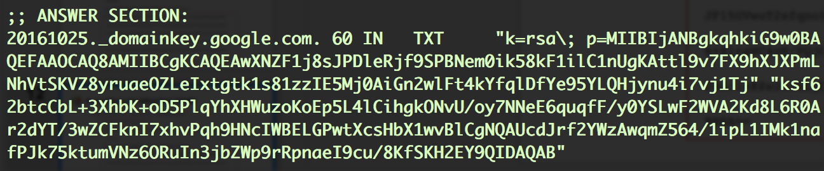
DKIM DOMAIN CONFIGURATION
Notes:
El que recive el correo

Slide 17
DKIM PITFALLS
No action on invalid signature on protocol
No replay protection
Only authenticates the signer, not the sender
Security depends on the secrecy of the private keys
DKIM RFC
DKIM has some degree of assurance that the FROM field is likely to be valid.
Still, presumptions of the FROM field validity remain a concern.

Slide 18
AGENDA
Email Intro
DMARC
Serverless Solution
Threat Intel
Conclusions

Slide 19
DMARC TO THE RESCUE
Domain-based Message Authentication, Reporting and Conformance (policy)
Unifies SPF and DKIM into common framework
DNS TXT record for FROM domain
Requires alignment between SPF, DKIM and FROM
(SPF pass AND aligned) OR (DKIM pass AND aligned)

Slide 20

SPF ALIGNED
Envelope From
Return-Path: postmaster@example.com
Authentication-Results: mx.mail.com; spf=pass (mail.com: domain of postmaster@example.com designates 10.1.1.1 as permitted sender) smtp.mail=postmaster@example.com
From: "Postmaster" <postmaster@example.com>
FROM
DKIM Domain = None

Slide 21

SPF NOT ALIGNED
Envelope From
Return-Path:postmaster@phish.com
Authentication-Results: mx.mail.com; spf=pass (mail.com: domain of postmaster@phish.com designates 10.1.1.1 as permitted sender) smtp.mail=postmaster@example.com; dkim=fail header.i=@example.com
DKIM-Signature: v=1; a=rsa-sha256; d=bar.example.com; s=s1024-2011-q2; c=relaxed/simple; q=dns/txt; i=@example.com; t=1337318096; {. . .}
From: "Postmaster" <postmaster@example.com>
FROM

Slide 22
DKIM ALIGNED
Return-Path: postmaster@example.com
Authentication-Results: mx.mail.com; spf=neutral (mail.com: domain of postmaster@example.com does not designate 10.1.1.1 as permitted sender) smtp.mail=postmaster@example.com; dkim=pass header.i=@foo.example.com
DKIM-Signature: v=1; a=rsa-sha256; d=foo.example.com; s=s1024-2011-q2; c=relaxed/simple; q=dns/txt; i=@foo.example.com; t=1337318096; {. . .}
From: "Postmaster" <postmaster@example.com>
FROM

Slide 23
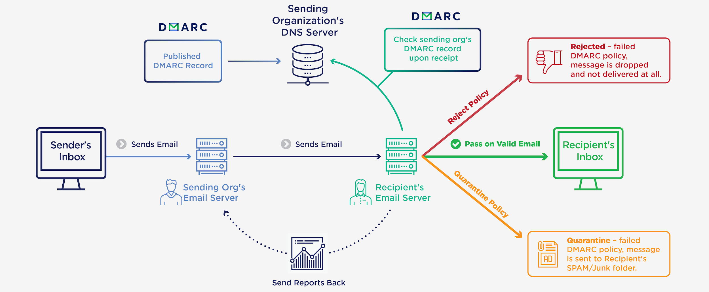
REPORTING
Source: https://dmarc.globalcyberalliance.org/

Slide 24

CONFORMANCE
_dmarc.facebook.com TXT
v = DMARC1;
p = reject;
pct = 100;
rua = mailto:postmaster@facebook.com;
ruf = mailto:d@ruf.agari.com;
[none|quarantine|reject]
Notes:
Reciben el correo que hacer si no hay alineamiento

Slide 25
AGENDA
Email Intro
DMARC
Serverless Solution
Threat Intel
Conclusions

Slide 26
THE SERVERLESS APPROACH
Minimum viable product
No servers maintenance effort
No devops / security expertise
Monitoring and alerting
Low cost $$

Slide 27
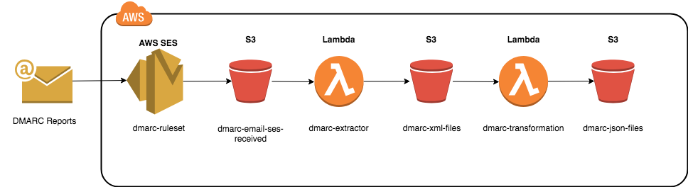
DMARCLESS

Slide 28
DMARCLESS

Slide 29
DMARCLESS
Notes:
Lambda permite ejecutar codigo sin la necesidad de tener servidores

Slide 30
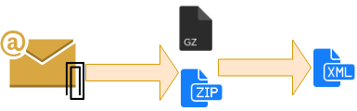
DMARC EXTRACTOR LAMBDA

Slide 31
DMARCLESS

Slide 32
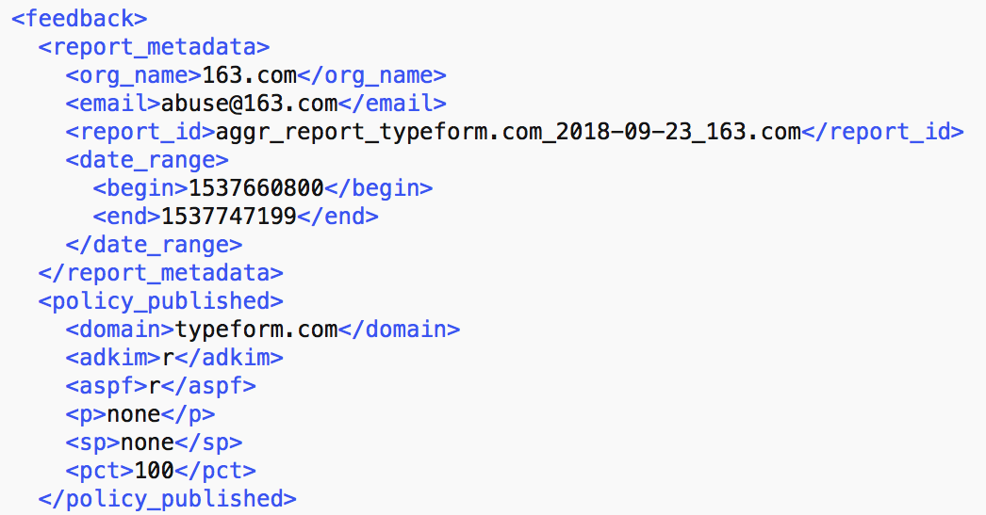
TRANSFORMATION LAMBDA
Reporter Metadata
Policy

Slide 33
TRANSFORMATION LAMBDA

Slide 34
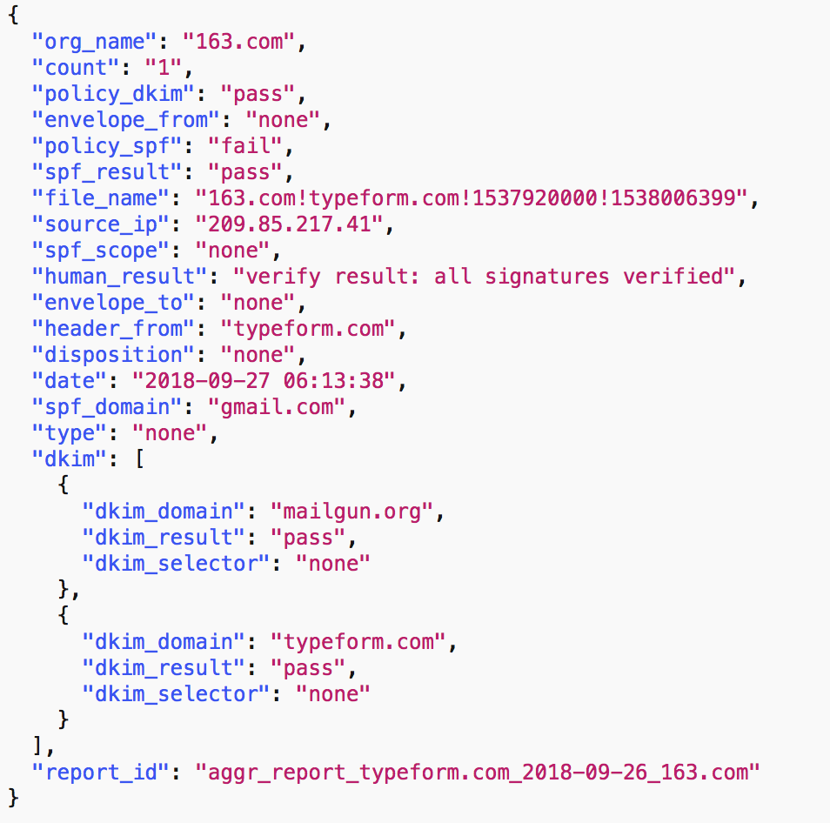
TRANSFORMATION LAMBDA

Slide 35
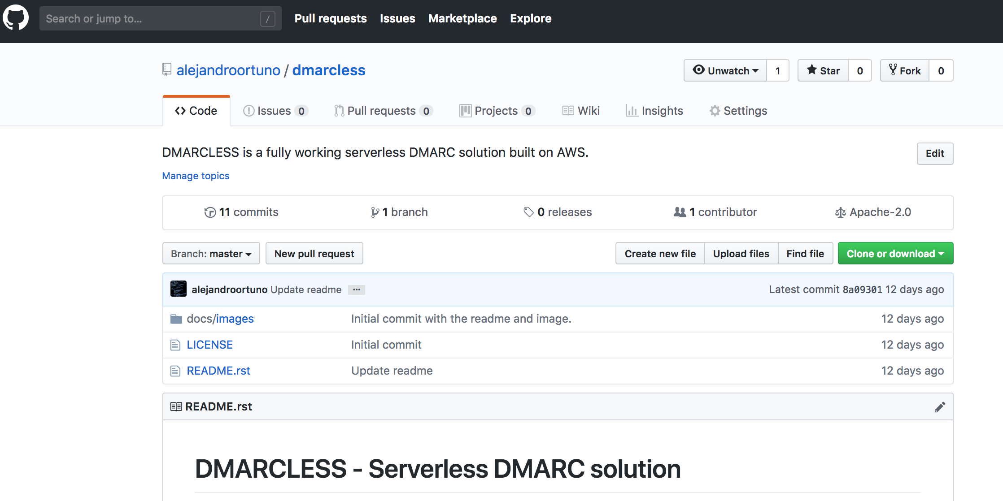
OPEN SOURCE - DMARCLESS
Source: https://github.com/alejandroortuno/dmarcless

Slide 36
AGENDA
Email Intro
DMARC
Serverless Solution
Threat Intel
Conclusions

Slide 37
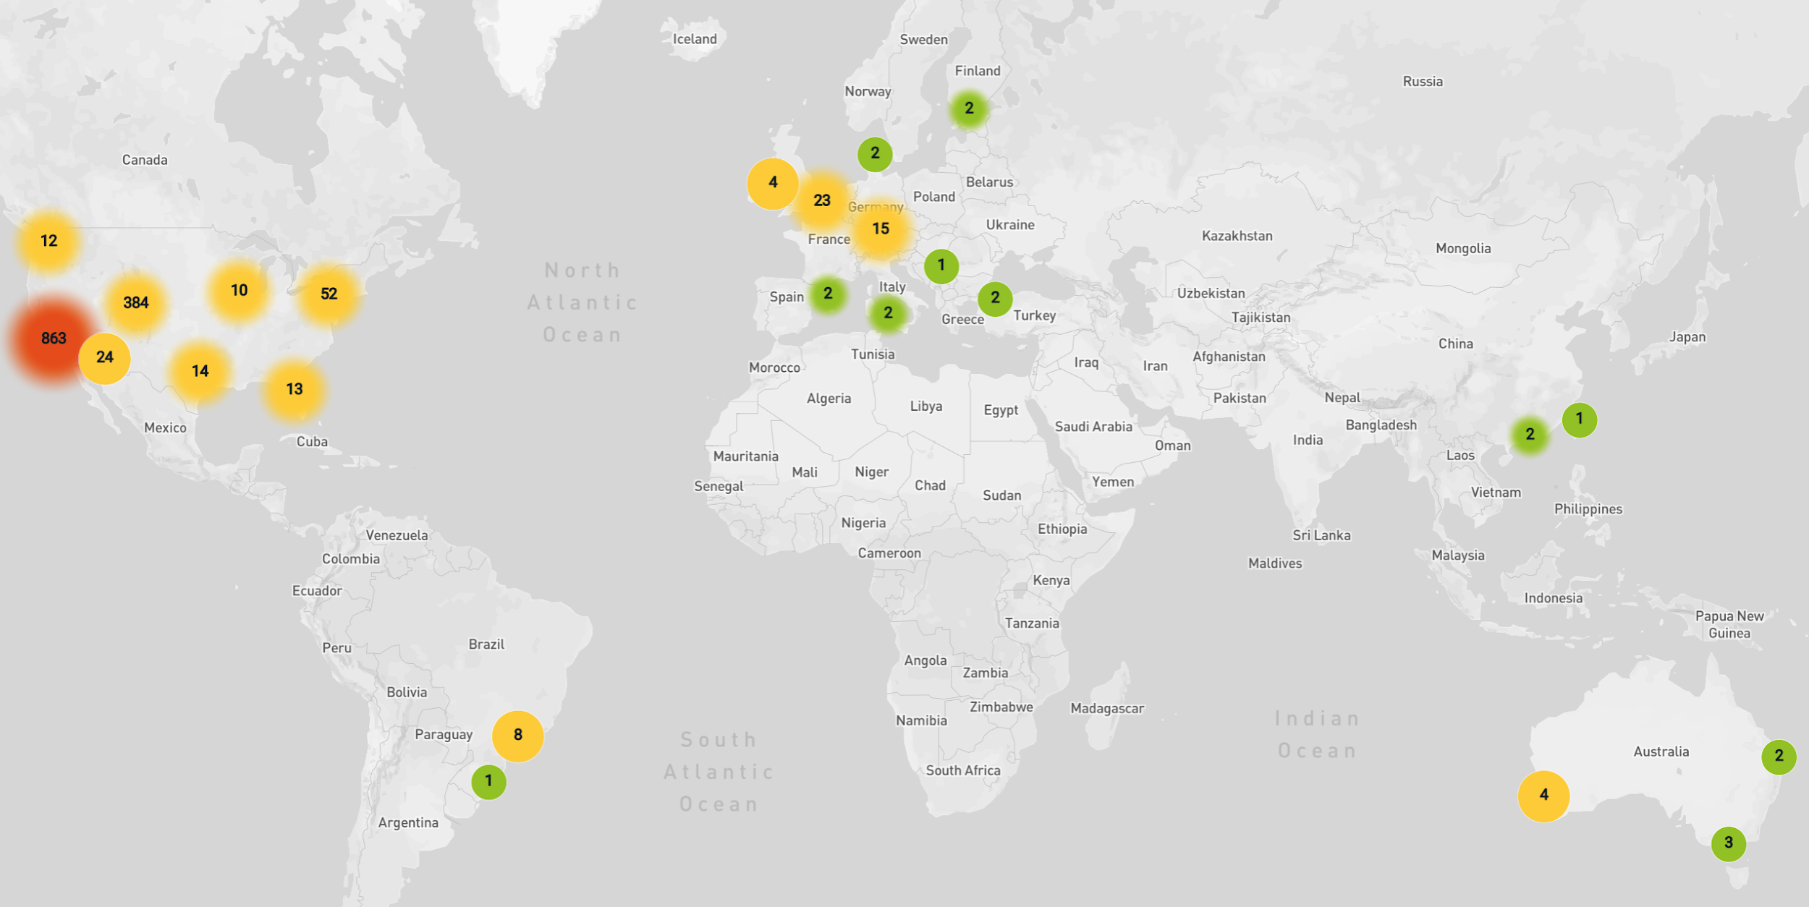
SOURCE_IP
Notes:
Filter out the IPs for the mailing services used

Slide 38
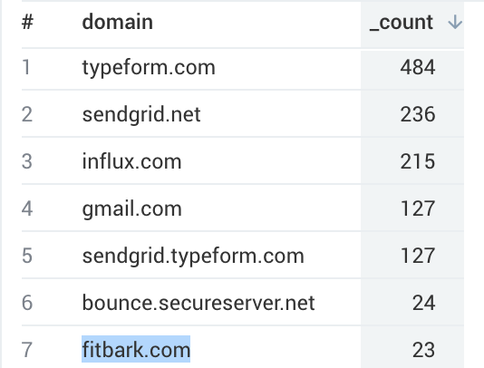
SPF_DOMAIN & DKIM_DOMAIN

Slide 39



Slide 40
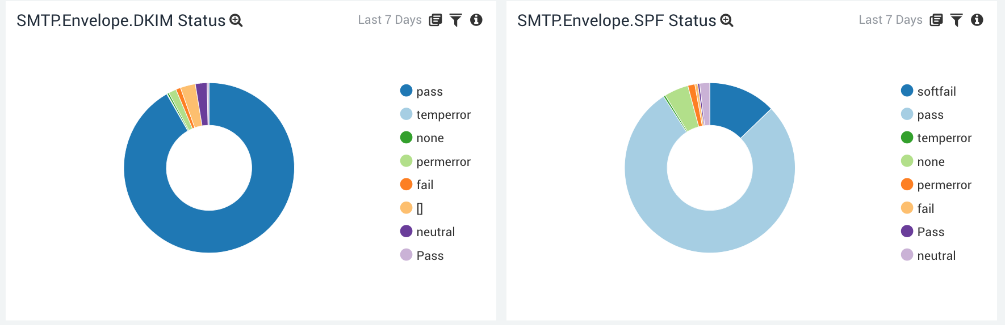
SPF_RESULT & DKIM_RESULT

Slide 41
AGENDA
Email Intro
DMARC
Serverless Solution
Threat Intel
Conclusions

Slide 42
ON THE POSITIVE SIDE
Visibility, visibility and visibility
Worth even with “p=none”
Onboard more intelligence
Defense in depth
Very cheap solution if you do not have $$$

Slide 43
ON THE DARK SIDE
Non-compliant XML, typos, wrong case, incomplete reports ...
Hard to justify proprietary solutions $$$
Rollout almost impossible if you have a “marketing” team
Mailing Lists behaviour - break SPF & DKIM
Forget about real time response
Not every MTA supports it - enforce / report
Prevent spoofing only - email permutations?
Attacks: XML parsing, ZIP uncompressed, Polluting results
Notes:
Separate transactional email to marketing as much as possible

Slide 44
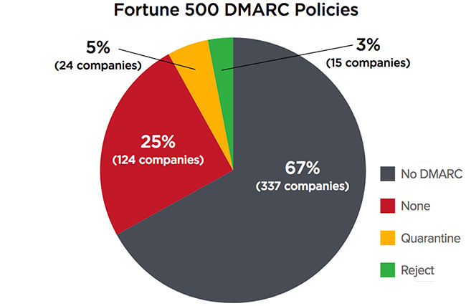
Source: https://www.securityweek.com/dmarc-adoption-low-fortune-500-ftse-100-companies
Notes:
Separate transactional email to marketing as much as possible

Slide 45
FUTURE - ARC
Authenticated Received Chain Protocol
Solves problem with Mailing Lists
Intermediaries forward encrypted DMARC status to next hop
Google is rolling this out
Notes:
Separate transactional email to marketing as much as possible

Slide 46

@aomanzanera
alejandro.omanzanera@gmail.com

